Slide 1
Systemic Change Grant Information Webinar
2023 Cycle

Slide 2
Prayer for Vincentians about to Engage in Systemic Change
May God be with us as we serve those in need.
May we find creative ways to assist them in becoming independent.
May we pray for unity amongst Vincentians throughout the world.
May we explore new ways to teach and learn from those we serve.
May we pray for the Holy Spirit to guide us on the Vincentian Pathway to ending
poverty as we now know it.
May we find courage and stamina to improve the structural systems that keep
our friends in need in their place at the bottom of the ladder. May we stand with them
and for them in their struggles for justice in the care provided for and to them.
May God bless all of us knowing we are all doing our part to improve the system of
care for those in need.

Slide 3
What is our definition of systemic change?
shifting the conditions that hold poverty in place
Our work moves people a step closer to financial stability. What are the situations the keep a neighborhood or community in need? What can we do to impact people we don’t meet to get on a path to stability?
THINK LONG-TERM IMPACTS:
Does the project have a great deal of social impact? Is it innovative or revolutionary? Making any changes toward Systemic Change is better than standing still.

Slide 4
GRANT CRITERIA
Engagement – Involve people with lived experience & their neighbors at all stages of planning.
Far-reaching social impact – Ensure that the S. C. project transforms attitudes in individuals and communities. Does the project include advocacy to help shift the conditions that hold poverty in place?
Sustainability – Will the project, & the participants, eventually be self-sufficient?
Replicability – Can other Councils and Conferences implement a similar project?
Innovation – Does the approach simply increase our capacity to provide services faster or better, or does it reduce or eliminate the need for those services?
Collaboration – Does the project engage all sectors of the community?
Data Driven – Assess progress, adjust, and achieve project goals.

Slide 5
St. Ambrose Conference Cheverly, Maryland
Darrell Matics, Treasurer and Grant Writer

Slide 6
Family to Familia Scholarship Program
Description: Scholarships to students from Sister Parish in San Agustin, El Salvador to attend University and Technical School
Goal: Pathway out of poverty for young people, reduce harmful impacts of emigration on families, strengthen local community
Existing program - working with San Agustin beginning in 2007, scholarship program began 2012

Slide 7
OUR Systemic Change Grant
•How long did it take to complete the application?
About 4 hours to complete the form including editing time
Several weeks to understand the goals of Systemic Change and realize why our Scholarship Program was a good fit.
Several years to understand the specific problem we are working on

Slide 8
Systemic Change Lessons LEarned
•Focus on creating change to the root cause of the problem. Goals must be practical.
In San Agustin, poverty is caused by lack of opportunities for the young, the consequence is emigration, separation of families and loss of talent the local community
In Maryland, poverty among immigrants is often due to lack of education and legal status
•We cannot solve immigration, but we can provide some young people opportunities for education and employment in their country

Slide 9
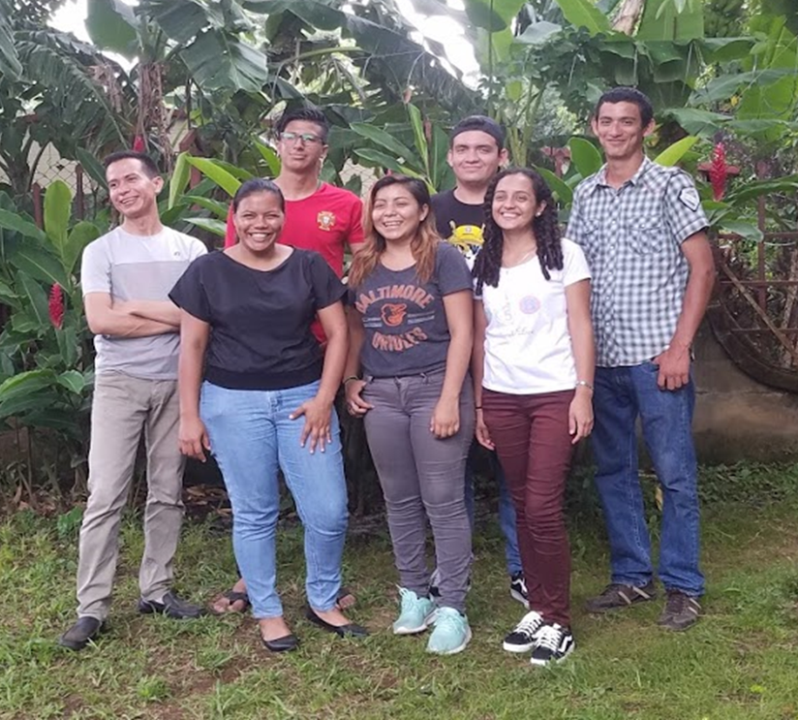
Family to Familia Scholarship program
ST. AMBROSE CONFERENCE CHEVERLY, MARYLAND

Slide 10
What are not systemic change programs?
Rent Payments
Food pantries
Pharmacies

Slide 11
Online application
The Application form should be brief (no more than two pages) that includes:
1. Program Description: A couple paragraphs the explain the root cause of poverty in the community being addressed, what the program does, how you know it will address the root cause, specific populations served (if relevant), and duration.
2. Statement of Need: In a few sentences, describes how the program embodies at least some of the Systemic Change program criteria.
3. Desired Outcomes: Tell us the desired outcome of your program.
4. Amount Requested: The total amount requested and how the funds will be spent (can be a brief paragraph, a full proposal will need a detailed budget).

Slide 12
Grant Timeline
Info Webinar
TODAY, June 27
Application Due
Friday, July 21
Winners Announced
Thursday, August 16

Slide 13
SCORING RUBRIC is on the website (AKA - The answers to the test)
How well do you describe how you will meet the following criteria:
Engagement
Far-Reaching Social Impact
Sustainability
Replicability
Innovation
Collaboration
Data Driven

Slide 14
Systemic Change grant resources
Systemic Change Grants Webpage https://ssvpusa.org/systemicchange/systemic-change-grantmaking/
Questions can be directed to Steve Uram, National Director of Poverty Programs, or Becca Kazdoy, Manager of Poverty Programs at systemicchange@svdpusa.org.

Slide 15
Questions?

Slide 16
Closing prayer: Voice of the Poor Prayer
Lord of all people,
During your time on Earth, you identified with the poor and instructed us to care for
one another, for our neighbor and especially for the least of our brothers and sisters.
Be with us as we advocate for the poor. Help us to persevere in joy and love on their behalf.
Add your voice to ours as we speak out for those who are not heard in our communities.
Guide us as we work, comfortable in the knowledge that we are doing your will for
this day and time and place, and that you will take care of tomorrow.
We ask this in the name of Jesus, his Blessed Mother, our patron St. Vincent and
our founder Blessed Frederic.

